Slide 1
Context-Aware Conversational Developer Assistants
Nick Bradley | University of British Columbia
Thomas Fritz | University of Zurich
Reid Holmes | University of British Columbia
Notes:
[Hi, I’m Nick]. Thanks for coming to this talk where I’ll be presenting some of my Master’s research; which looks at automating developer workflows with conversational assistants.
This work was done in collaboration with Thomas Fritz and Reid Holmes.

Slide 2
Patch Workflow
Notes:
Let’s start by looking at one common workflow which a developer might use when fixing a bug.

Slide 3
I’m ready to start working on my next bug report.
Notes:
So here we have a developer who’s thinking “I’m ready to start working on my next bug”. Now, let’s imagine you are the developer and look at what actions you would need to do to actually start working on the bug.

Slide 4
I’m ready to start working on my next bug report.
Open Issues Devy
#25 Ability to…
#37 Critical b…
#37 Critical b…
#39 Feature …
⋮
Notes:
First, to get the next bug report, you would need to
#Open your web browser,
#Navigate to your issue tracker,
#Sort your bug reports by priority
#Select report number 37, the highest-priority report

Slide 5
I’m ready to start working on my next bug report.
> git checkout -b iss/37
> cd /home/nb/devy
Notes:
Then you would:
#Open your terminal
#Change to the project directory (how?)
#Checkout a new branch (team policy to include the issue number in branch name; need to remember; #then you can checkout the branch)

Slide 6
I’m ready to start working on my next bug report.
Notes:
Finally, you would:
#Launch your editor or IDE (navigate to project in file selector)

Slide 7
…
Notes:
Okay, so now you’ve done all the steps necessary to start working on the bug. The steps weren’t all that hard, but there were a lot of them and it can be tedious for you to maintain contextual awareness throughout the process.
Of course, actually fixing the bug will probably take the majority of the developer’s time and energy but that’s exactly where we want the developer to be spending their time – not getting their tooling set up.

Slide 8
I’m done! Let’s push out those changes.
…
Notes:
Now that you are done fixing the bug, you will need to share your changes.

Slide 9
I’m done! Let’s push out those changes.
> git push
> git pull
> git commit -m “closes #37”
> git commit -m “???”
> git add -A
…
Notes:
So, you:
#Switch back to the terminal
#stage your changes with git add
#commit your changes (again, it’s team policy to link commits to issues; forgot)
#Re-open your issue tracker and look up the issue number
#Switch back to the terminal
#commit
#Pull
#Push your changes.

Slide 10
I’m done! Let’s push out those changes.
Create pull request on iss/37
Assign @mark
…
Notes:
Now you:
#Browser
#GitHub
#Create PR (branch name)
#Assign reviewer

Slide 11
I’m done! Let’s push out those changes.
Add comment “fixed in PR #11”
…
Notes:
Finally, you’ll need to navigate to your issue tracker
#Add a comment linking the issue to the PR (using the PR id from previous step)
So that was a quite tedious. Sorry. But it really is what developers have to do. And notice that even after we finished fixing the bug, there were still several bookkeeping steps that we had to complete before actually being finished.

Slide 12
5 switches
Issue #37
Path /home/nb/devy
Project Devy
Branch iss/37
3 apps
+ 3 tools
PR #11
11 actions
Create comment
Get next issue
Change directory
…
Stage files
Create pull request
Create branch
Commit files
Assign reviewer
Open project
Get changes
Submit changes
Notes:
In fact, even in this small, relatively easy example there was a lot going on:
You needed to switch # 5 times between # 3 applications: # your browser, # your terminal, and # your IDE, and
Within those applications, you needed to use # 3 different tools to invoke #11 actions
Requiring you to accurately remember # 5 pieces of contextual information
By looking at these workflows in detail, we can see how cognitively demanding and potentially error-prone these manual interactions can be. And…

Slide 13
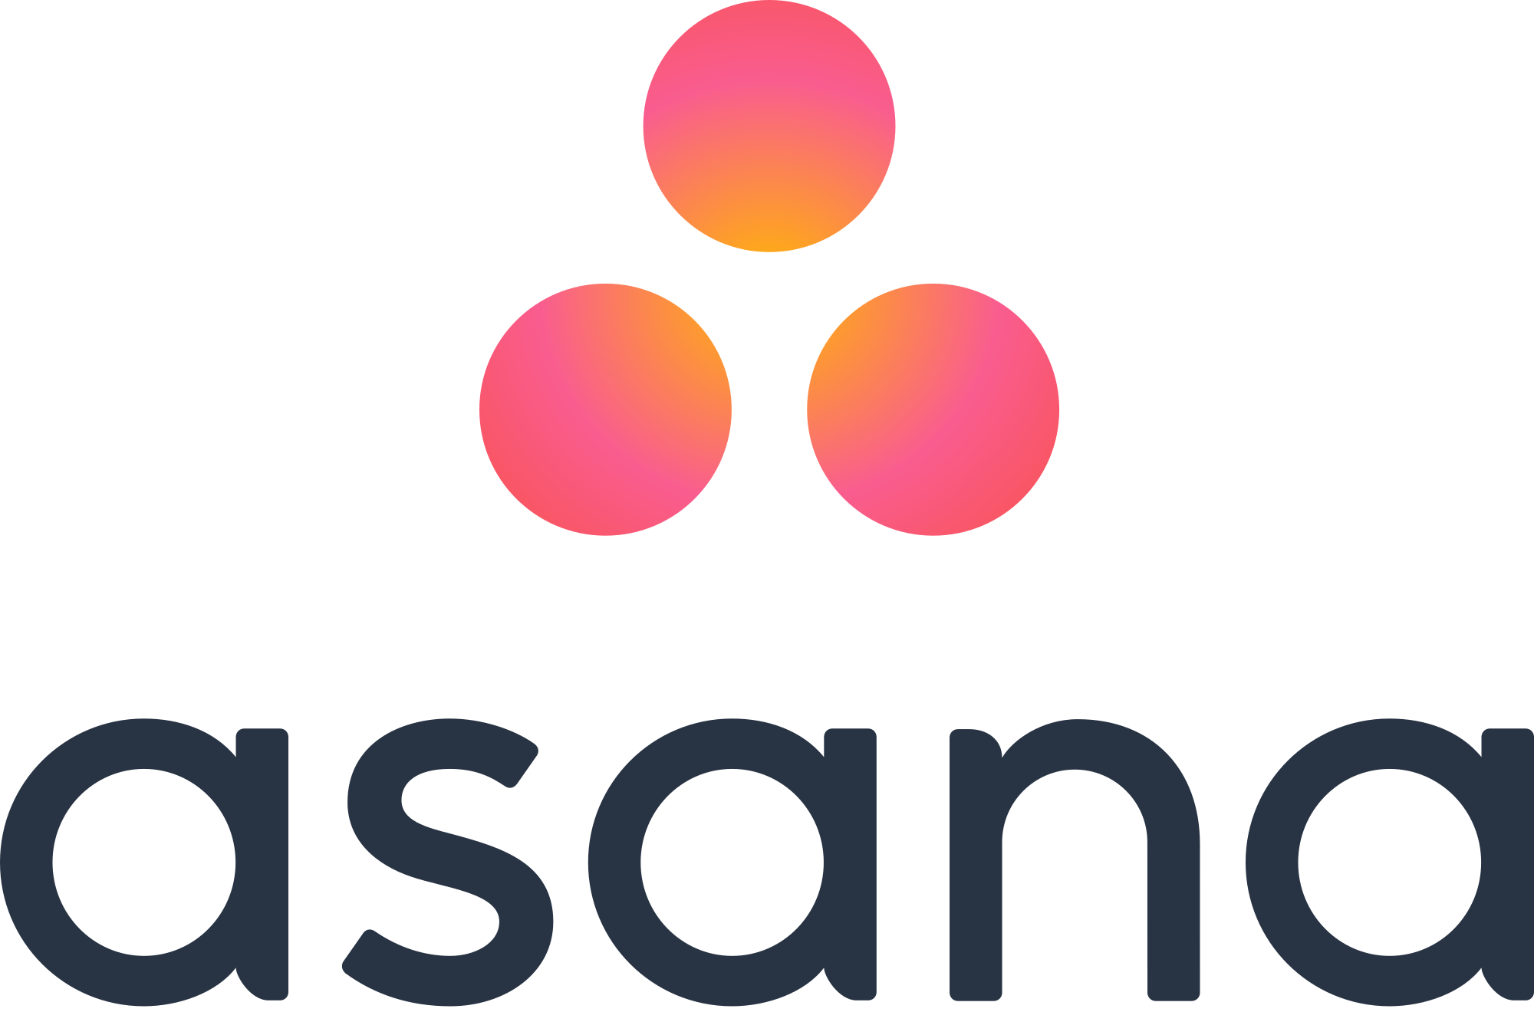
Notes:
There are WAY more tools and workflows out there. When we talked with industrial developers, they mentioned several other workflows they either had to do manually or had to explicitly automate themselves. For example
Getting IP address of deployed AWS containers, or
Trying to figure out who owns a file using version history.
One of the developers also mentioned that, while he thought using static analysis tools would improve his team’s code, the tools were just too complicated to be integrated effectively into his team’s manual workflows.
These are all nice examples of where an automated assistant could help developers be more productive. So let’s see what that assistant might look like…

Slide 14
Assisted Patch Workflow
Notes:
We’ll do the same bug fix workflow as before, but this time using an automated assistant we developed called Devy.

Slide 15
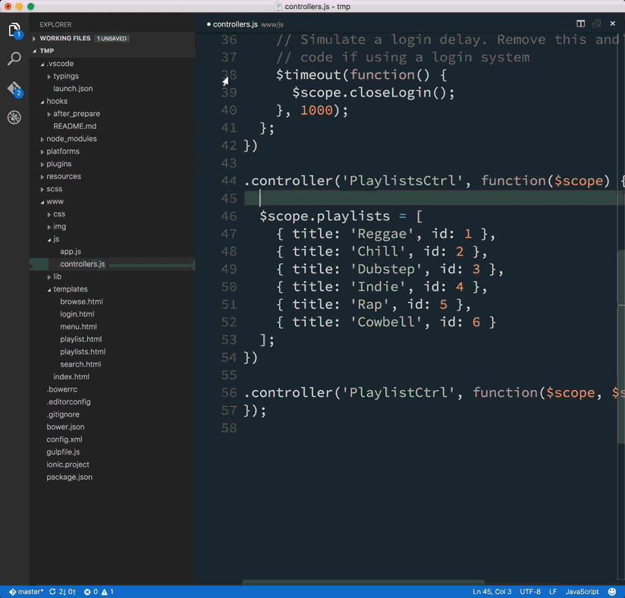
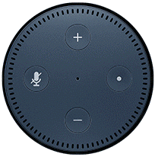
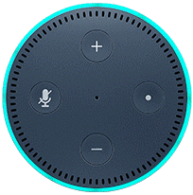
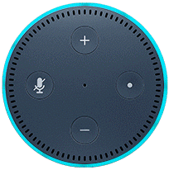
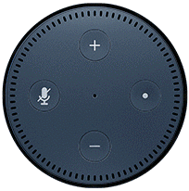
Alexa, tell Devy I’m done.
Alexa, tell Devy I want to start my next item.
I’m ready to start working on my next bug report.
Terminal
> ./run-devy-client
Waiting for developer request...
Create Pull Request
Issue 37
Got request to start next item; assuming latest project: devy.
Bug fix for #37
Problem using <polygon> in JSX with 0.10.0
Getting list of issues from Jira...
See the [issue](https://jira.devy.com/issues/37)
You are assigned to 19 issues. Highest priority issue: #37.
You are ready to work on issue 37.
Had some JSX the included code like this:
<svg version="1.1" id="Layer_1" x="0px" y="0px" viewBox="-79.4 0 48.7 56.1">
<polygon className="logomark" points="-55.1,55.6 -79,41.8 -79,14.2 -55.1,0.5 -31.2,14.2 -31.2,41.8 "></polygon>
</svg>
Was given the following error in the console: ReferenceError: polygon is not defined
Seemed to work when I added this line before the return in my render function: var polygon = React.DOM.polygon;
Okay, I’ve pushed your changes and opened a pull request.
Creating branch: iss/37
Preparing to launch vscode...
Staging files
Committing changes with message “closes #37”
Pulling latest changes...
Success (no conflicts)
Pushing changes...
Success
Creating empty pull request: master..iss/37
Pull request #11 created
Analyzing commit for best reviewer...
Assigning @mark
Adding issue comment “fixed in PR #11”
Launching PR comment dialog...
Cancel
Submit
Hide
…
Notes:
So you’re still thinking you are ready to start working on your next bug report; but # now you have an automated assistant that can execute workflows for you.
After you start # Devy’s backend on your local computer, you can prepare your environment by simply saying: “Alexa#, tell Devy I want to start my next item”#.
Then Devy will execute the necessary tools and API calls on your behalf.
<wait>This opens your editor to the current project and displays the description of the bug report so you can begin working immediately # … #.
Then to share your changes, you can say “Alexa, #tell Devy I’m done”. And then it automatically executes the steps as before which you can see in the terminal.
#<wait>Which creates an empty pull request and then gives you the opportunity to add some comments. If we compare this with manual approach earlier, we see that this is much more direct: when you’re done, you just say “I’m done” and all of the bookkeeping steps are completed automatically by the assistant.
Now, we’ve simplified the interactions for the demo a bit, but I’ll just note that Devy also has the ability to prompt the developer for additional information and then act accordingly.

Slide 16
Research Questions
RQ1 How well can an assistant support basic development tasks?
RQ2 For which workflows would an assistant be useful and why?
Notes:
So now you’ve hopefully gotten a sense of how conversational developer assistants, or CDAs, like Devy can help automate workflows. This raises two research questions #...#.
Now, people have already look at supporting developers using context models, natural language interfaces, and even other types of bots; but none have looked at supporting developer workflows using automated assistants. So we developed Devy as a technology probe to help answer our research questions. So let’s just quickly look at how Devy was implemented…

Slide 17
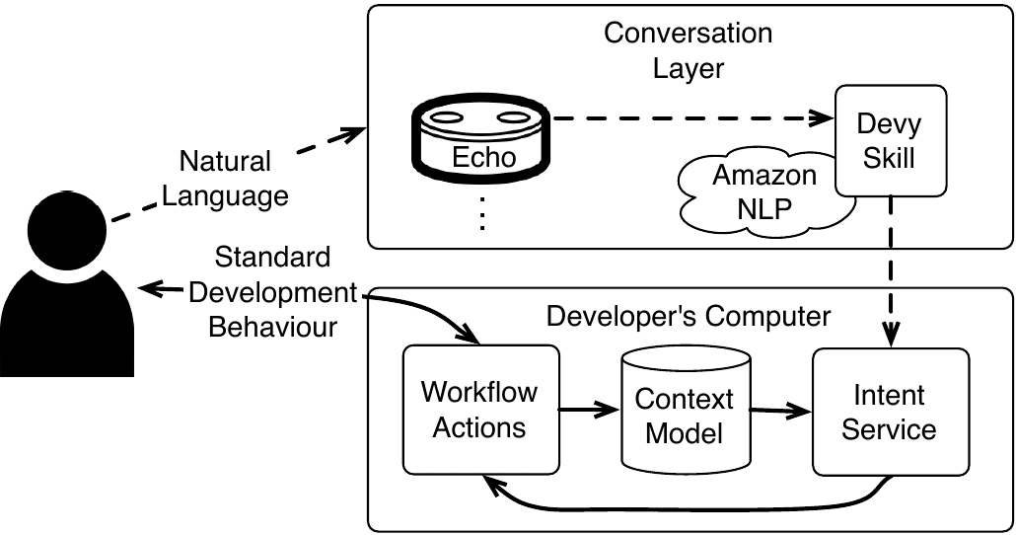
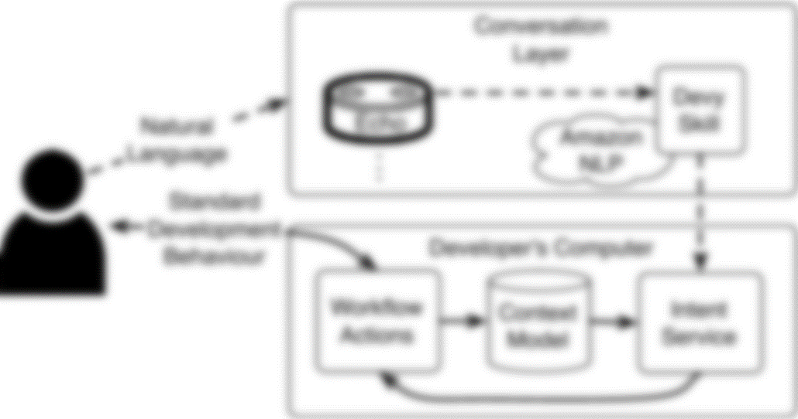
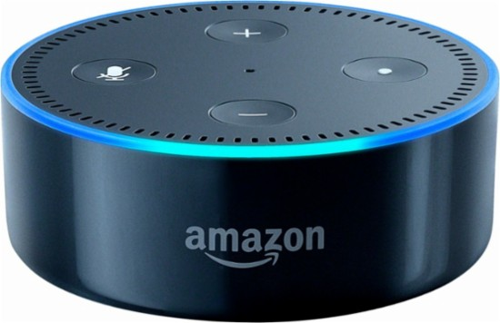
Implementation
Notes:
So here is our architecture diagram, and let’s just walk through it quickly.
# An assistant obviously needs some way to interact with the developer. As you saw in the demo, we use voice interaction through an Alexa app called Devy, that takes advantage of Amazon’s natural language understanding capabilities. Essentially, we created a set of sample utterances for each task we wanted Devy to support and then provided them as training data to Alexa.

Slide 18
Implementation
Issue 37
Path /home/nb/devy
Branch iss37
Key | Value
Issue | 37
Project | devy
Path | /home/nb/devy
… | …
Project Devy
Files main.ts
PR 11
Notes:
We also have an agent running on the developer’s computer that keeps track of all of those pieces of information the developer had to remember earlier like the issue number and the branch name. This context model could also keep track of much more like say test status, build status, deployment configurations, and reslly any other information that needs to be carried across tools.

Slide 19
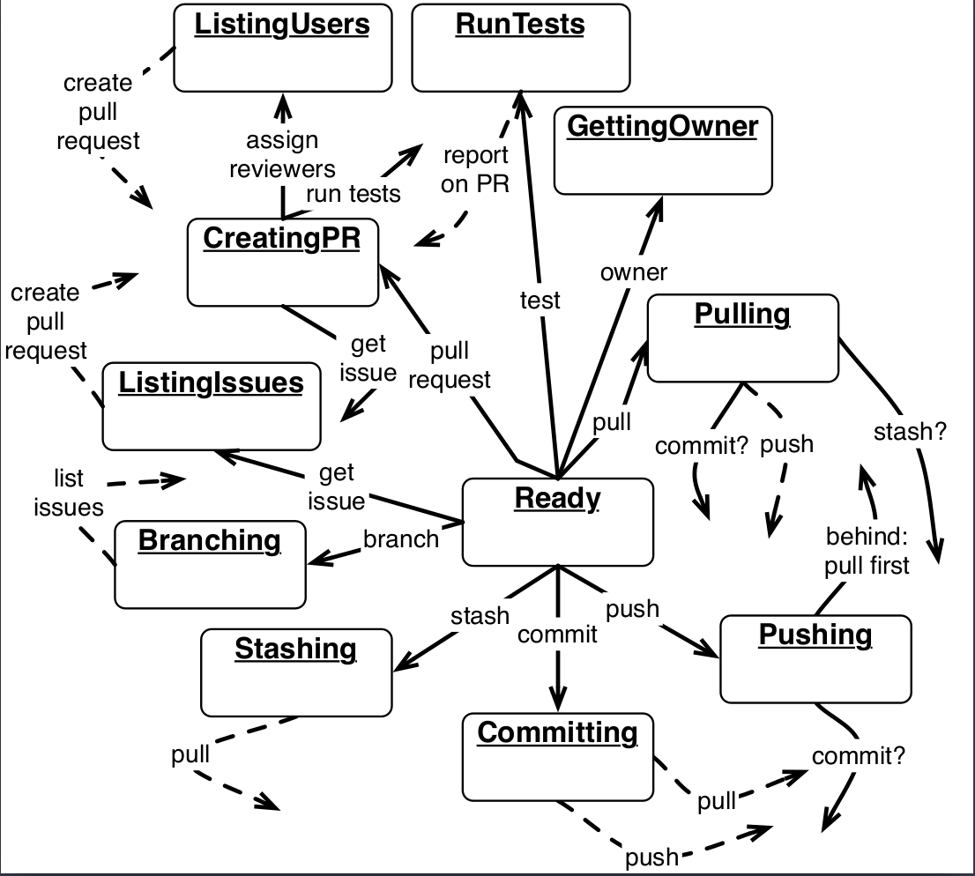
Implementation
Notes:
Finally, there’s a lot of complexity to leverage this contextual information across tools, including tools in the terminal and on the web; and to deal with this in our technology probe, we used a stack-based finite state machine (FSM). This FSM also runs locally on the developer’s computer and is updated by changes in context and by intentions received from the Alexa service during developer interaction.
So Devy is not just a passive bot, but it actually does execute workflows that help the developer.

Slide 20
Evaluation
Research Questions
How well can an assistant support basic development tasks?
For which workflows would an assistant be useful and why?
Participants
21 professional software engineers at 6 companies in Vancouver
Procedure (approx. 30 minutes)
Semi-structured interview exploring use cases for CDAs
Observed developers performing 3 tasks with Devy
Semi-structured interview to assess value, usability, and other uses cases
Notes:
To answer our two research questions, we conducted a mixed-methods study with 21 professional software engineers. To avoid priming the participants, we first had them tell us for which scenarios they thought a voice assistant would be most useful. Then we had them complete three development tasks with our Devy technology probe and concluded with a few more questions about their experience.

Slide 21
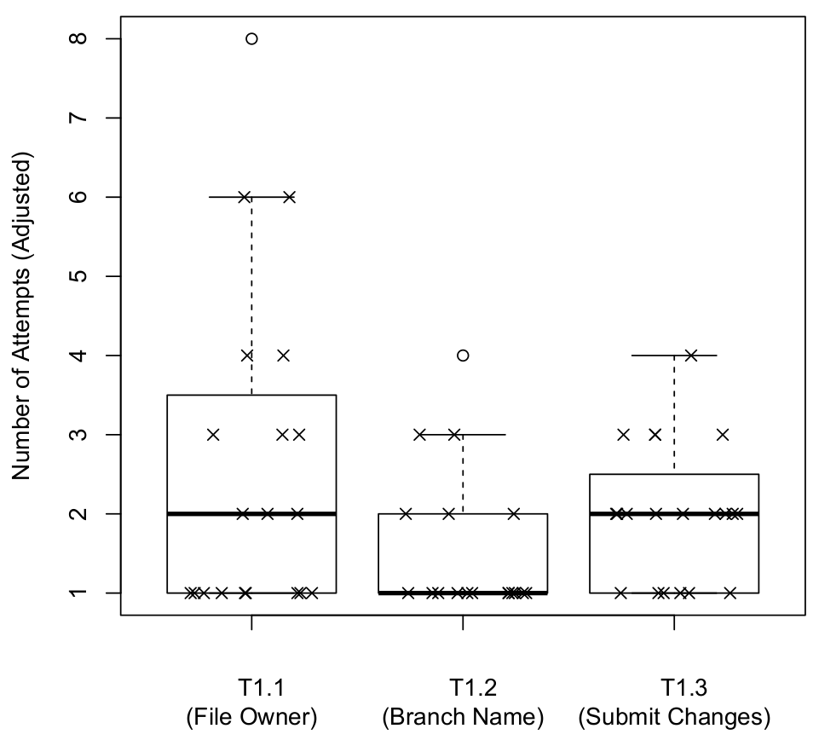
Completing Development Tasks With Devy
RQ1: How well can an assistant support basic development tasks?
Number of Attempts (Adjusted)
Identify file owner
List the current git branch
Commit and push changes
Task
Notes:
To help answer our first research question, we asked the participants to complete 3 basic development tasks, shown on the x-axis:
Get the name of the person who “owned” the file, having made the most changes to the file,
Get the currently checked-out branch,
Submit changes to the version control system
They completed these tasks through voice interaction with Devy and…

Slide 22
Completing Development Tasks With Devy
8
7
6
5
Number of Attempts (Adjusted)
Number of Attempts
4
3
2
1
Identify file owner
List the current git branch
Commit and push changes
Task
Notes:
Then we counted the number of attempts it took to complete the task, shown on the y-axis.

Slide 23
Completing Development Tasks With Devy
8
7
6
5
Number of Attempts (Adjusted)
Number of Attempts
4
3
2
1
Identify file owner
List the current git branch
Commit and push changes
Task
Notes:
For getting the owner of a file, there as some variation in the number of attempts largely due to Devy being trained with utterances focusing on file ownership while the task was phrased more around the number of commits made. The outlier was due to a combination of missing one of the two names “Alexa” or “Devy” and not invoking the skill with utterance Devy understood. Also, for many participants, this was there first time really using a voice assistant.

Slide 24
Completing Development Tasks With Devy
8
7
6
5
Number of Attempts (Adjusted)
Number of Attempts
4
3
2
1
Identify file owner
List the current git branch
Commit and push changes
Task
Notes:
The second task, getting the currently checked-out branch, was completed faster by most participants. The one participant who took 4 attempts paused between invoking Devy and issuing the command; that’s something that would be resolved after spending more time interacting with the device.

Slide 25
Completing Development Tasks With Devy
8
“Alexa, tell Devy to push to GitHub.”
—P15
“I was just thinking it knows the context about what I’m talking about. That’s kind of cool.”
—P2
7
6
5
Number of Attempts (Adjusted)
Number of Attempts
4
3
2
1
Identify file owner
List the current git branch
Commit and push changes
Task
Notes:
Finally, participants took a median of 2 attempts to complete the final task. In this case, the two attempts are the result of participants using standard git interactions where you first commit and then push. However, some participants took advantage of Devy’s automation and said directly: # “Alexa, tell Devy to push to GitHub” which caused Devy to ask the developer whether they wanted to commit their outstanding changes. This is another example of how Devy can reduce cognitive overhead by letting the developer intentionally NOT think about the individual actions required to complete the workflow.
One interesting observation that came out of this experiment was, at the start participants we very verbose when giving their commands (for instance, including the name of the currently opened file), but as the session progressed, participants spoke more naturally by saying “this” in place of the file name. Also, one participant noticed the automatic context tracking and commented: # “I was just thinking it knows the context about what I’m talking about. That’s kind of cool.”

Slide 26
Benefits & Use Cases
Reduce necessary application and contextual switches
Automatic mapping of higher-level tasks to commands
Reduce the need for memorization
Manage multiple tasks
Support multi-step and cross-application tasks
Reduce explicit specification of context
Enforce team processes
Workflow history
Alternative to typing/GUI
“lose [..] concentration on the thing I’m looking at”
—P6
“…I usually have a ton of consoles open and switching over really confuses me…”
—P7
Notes:
Here, I’ll discuss some of the benefits and use cases we identified through open coding the interview transcripts.
<switches>Participants generally agreed that reducing both task switches and application switches would help developers avoid # “losing concentration on the things they’re looking at” especially since they # “can have a ton of consoles open and switching between them can be really confusing”.

Slide 27
Benefits & Use Cases
Reduce necessary application and contextual switches
Automatic mapping of higher-level tasks to commands
Reduce the need for memorization
Manage multiple tasks
Support multi-step and cross-application tasks
Reduce explicit specification of context
Enforce team processes
Workflow history
Alternative to typing/GUI
“…if I can do these high-level tasks with a brief command [..] rather than break them down into a sequence of git commands + switching to the browser + [..], it would be a win.”
—P19
“…I usually have a ton of consoles open and switching over really confuses me…”
—P7
Notes:
<mapping>Several participants appreciated being able to express their # “high-level tasks with a brief command rather than having to break them down into a sequence of commands” manually.

Slide 28
Benefits & Use Cases
Reduce necessary application and contextual switches
Automatic mapping of higher-level tasks to commands
Reduce the need for memorization
Manage multiple tasks
Support multi-step and cross-application tasks
Reduce explicit specification of context
Enforce team processes
Workflow history
Alternative to typing/GUI
“…if I can do these high-level tasks with a brief command [..] rather than break them down into a sequence of git commands + switching to the browser + [..], it would be a win.”
—P19
“…do often enough to want a better interface but seldom enough that they can’t remember all the buttons”
—P10
“crazy flags that you’ve gotta remember every single time”
—P8
Notes:
<memorization>And participants thought that conversational assistants could help reduce the need for memorization especially for tasks developers #“do often enough to want a better interface but seldom enough that they can’t remember all the buttons” or where developers need to specify all those # “crazy flags that need to be remembered every single time”.

Slide 29
Benefits & Use Cases
Reduce necessary application and contextual switches
Automatic mapping of higher-level tasks to commands
Reduce the need for memorization
Manage multiple tasks
Support multi-step and cross-application tasks
Reduce explicit specification of context
Enforce team processes
Workflow history
Alternative to typing/GUI
Notes:
<manage tasks> We had one participant who thought Devy would be a great way to maintain team awareness and manage multiple tasks when working from home. The story was something like:
PR waiting for approval
Nothing else to do so I’m going to make lunch
I could be cooking and just ask Devy: “has it been approved yet?”
If it has then merge it before someone else gets their stuff in there
And participants had a couple of other suggestions for how Devy could help manage multiple tasks. For instance, setting reminders about other approaches to try while coding; or kicking off background processes like a build system without having to switch away from your current task and incurring the cost of the context switch.

Slide 30
Challenges & Future Work
“I imagine a room full of people talking directly to their computers would be a little chaotic.”
—P2
Voice interface
Transparency
Customization
Completeness: most workflows should be supported
Understanding: similar utterances might mean different things
Notes:
There were of course some challenges with CDAs which leads to some interesting future work. So, I’ll talk briefly about the first three.
<voice>In regards to the voice interface, all participants expressed negative sentiments; with one participant noting that <click> it would be a “little chaotic” in open office environments. However, some participants suggested that the voice interface could be useful and appropriate when working from home as we heard in that story. We are working to address this issue in office spaces by extending Devy to support a text-based interface.

Slide 31
Challenges & Future Work
“I imagine a room full of people talking directly to their computers would be a little chaotic.”
—P2
“I have to know exactly what [Devy] is doing behind the scenes”
—P8
“I have to know exactly what [Devy] is doing behind the scenes”
—P8
Voice interface
Transparency
Customization
Completeness: most workflows should be supported
Understanding: similar utterances might mean different things
Notes:
<transparency>Developers have to trust the CDA to do the right thing on their behalf. With only a voice interface, many of the steps are executed automatically based on typical behavior. One possible solution to increase transparency would be to display the commands that will be executed to the developer so that they # “know exactly what Devy is doing” and could then adjust the actions as necessary. This could also be one mechanism for Devy to become customized…

Slide 32
Challenges & Future Work
“I have to know exactly what [Devy] is doing behind the scenes”
—P8
“everyone’s got a little bit of a different workflow”
—P2
Voice interface
Transparency
Customization
Completeness: most workflows should be supported
Understanding: similar utterances might mean different things
Notes:
<customization>Since participants thought it would be helpful to have Devy learn and adapt to how people are using it or to be able to explicitly define the steps of a workflow. As we saw in the change task scenario earlier, there can also be team-based customizations that would allow different teams to enforce different processes. Devy could be an ideal platform for team workflows but this would require additional investigation.
More fundamentally though, we want to know:
What workflows are out there,
which ones are most common and
what are their characteristics since this will lead to more robust assistants.
However, there are # enough workflows that it’s unlikely that a conversational assistant could ever support them all.

Slide 33
Assisted Workflow Summary
Issue #37
Path /home/nb/devy
Project Devy
Branch iss/37
PR #11
Tracks context
Automates common workflows
Add comment “fixed in PR11”
Get next issue
Reduces cognitive overhead
$$⋯$$
create PR on iss37
Notes:
In summary, manual workflows require developers to maintain a high degree of # contextual awareness which imposes additional # cognitive burdens.
Many of the # workflows are simply “admin work” to keep systems “in sync” and take time away from tasks that truly require a developer’s expertise.
Context-aware conversational developer assistants can reduce the cognitive overhead to developers by tracking context and automating common workflows which can help developers be more productive.

Slide 34
“If you could do some [of these tasks] automatically, just by talking, I’d be really happy because [..] at the end of the day you start getting sloppy and holding [your] trains of thought in mind would probably be simpler if you weren’t changing [applications] so often”
—P7
Notes:
I just want to end with a quote that I think captures the goal of this research nicely. “…” Thank you.

Slide 35
Assisted Workflow Summary
Issue #37
Path /home/nb/devy
Project Devy
Branch iss/37
PR #11
Tracks context
Automates common workflows
Add comment “fixed in PR11”
Get next issue
Reduces cognitive overhead
$$⋯$$
create PR on iss37

Slide 36
Notes:
2 components
[Cloud vs Local computer]

Slide 37
Technology Probes
Simple, flexible, and adaptable
Three goals:
Understand needs and desires of users in a real-world setting
Test the technology in the field
Inspire users and researchers to think about new technologies
Notes:
But first, I’ll quickly describe what a technology probe is based on Hutchinson, et al’s 2003 CHI paper…
Technology probes are simple, flexible, adaptable technologies with three goals:
To understand the needs and desires of users in a real-world setting, the engineering goal of field-testing the technology, and the design goal of inspiring users and researchers to think about new technologies.
Technology probes are simple, flexible, adaptable technologies with three interdisciplinary goals: the social science goal of understanding the needs and desires of users in a real-world setting, the engineering goal of field-testing the technology, and the design goal of inspiring users and researchers to think about new technologies.

